Slide 1
COMP814 – Text Mining Pre-processing II POS Tagging Evaluation Parsing

Slide 2
Word Classes
Words that somehow ‘behave’ alike:
Appear in similar contexts
Perform similar functions in sentences
Undergo similar transformations
~9 traditional word classes of parts of speech
Noun, verb, adjective, preposition, adverb, article, interjection, pronoun, conjunction
Notes:
2

Slide 3
Reference
A lot (but not all) of the material in the following slides are from chapter 5 of the book:
Jurafsky and Martin (2000), Speech and Language Processing.

Slide 4
Some Examples
N noun chair, bandwidth, pacing
V verb study, debate, munch
ADJ adjective purple, tall, ridiculous
ADV adverb unfortunately, slowly
P preposition of, by, to, for, at
PRO pronoun I, me, mine, he his, her
DET determiner the, a, an,that, those
Notes:
4

Slide 5
Defining POS Tagging
The process of assigning a part-of-speech or lexical class marker to each word in a corpus:
WORDS
TAGS
the
koala
put
the
keys
on
the
table
N
V
P
DET
Notes:
5

Slide 6
Applications for POS Tagging
Speech synthesis pronunciation
Lead – verb versus noun
Parsing: e.g. Time flies like an arrow
Is flies an N or V?
Word prediction in speech recognition
Possessive pronouns (my, your, her) are likely to be followed by nouns
Personal pronouns (I, you, he) are likely to be followed by verbs
Machine Translation
Information extraction
Extract all clauses
Dominant concepts
Event modelling
etc
Notes:
6

Slide 7
Closed vs. Open Class Words
Closed class: relatively fixed set
Prepositions: of, in, by, …
Auxiliaries: may, can, will, had, been, …
Pronouns: I, you, she, mine, his, them, …
Usually function words (short common words which play a role in grammar)
Open class: productive
English has 4: Nouns, Verbs, Adjectives, Adverbs
Many languages have all 4, but not all!
In Lakhota and possibly Chinese, what English treats as adjectives are more like verbs.
Notes:
7

Slide 8
Open Class Words
Nouns
Proper nouns
AUT, New Zealand, David Seymour, Metropolitan Transit Center
English capitalizes these
Many have abbreviations eg. Ack and CHCH
Common nouns
All the rest
German capitalizes these.
Notes:
8

Slide 9
Count nouns vs. mass nouns
Count: Have plurals, countable: goat/goats, one goat, two goats
Mass: Not countable (fish, salt, communism) (?two fishes)
Adjectives: identify properties or qualities of nouns
Color, size, age, …
Adjective ordering restrictions in English:
Old blue book, not Blue old book
In Korean, adjectives are realized as verbs
Adverbs: also modify things (verbs, adjectives, adverbs)
The very happy man walked home extremely slowly yesterday.
Notes:
9
Mass: is this singular or plural?

Slide 10
Directional/locative adverbs (here, home, downhill)
Degree adverbs (extremely, very, somewhat)
Manner adverbs (slowly, slinkily, delicately)
Temporal adverbs (Monday, tomorrow)
Verbs:
In English, take morphological affixes (eat/eats/eaten)
Represent actions (walk, ate), processes (provide, see), and states (be, seem)
Many subclasses, e.g.
eats/V ⇒ eat/VB, eat/VBP, eats/VBZ, ate/VBD, eaten/VBN, eating/VBG, ...
Reflect morphological form & syntactic function

Slide 11
How Do We Assign Words to Open or Closed?
Nouns denote people, places and things and can be preceded by articles? But…
My typing is very bad.
*The Mary loves John.
Verbs are used to refer to actions, processes, states
But some are closed class and some are open
I will have emailed everyone by noon.
Adverbs modify actions
Is Monday a temporal adverbial or a noun?
Notes:
11

Slide 12
Closed Class Words
Idiosyncratic
Closed class words (Prep, Det, Pron, Conj, Aux, Part, Num) are generally easy to process, since we can enumerate them….but
Is “up” a Particle or a Preposition?
George eats up his dinner/George eats his dinner up.
Articles come in 2 flavors: definite (the) and indefinite (a, an)
What is this in ‘this guy…’?
??
Notes:
12
Unique to an individual behavior

Slide 13
Choosing a POS Tagset
To do POS tagging, first need to choose a set of tags
Could pick very coarse (small) tagsets
Eg., N, V, Adj, Adv.
More commonly used: Brown Corpus (Francis & Kucera ‘82), 1M words, 87 tags – more informative but more difficult to tag
Most commonly used: Penn Treebank: hand-annotated corpus of Wall Street Journal, 1M words, 45-46 subset
Notes:
13

Slide 14
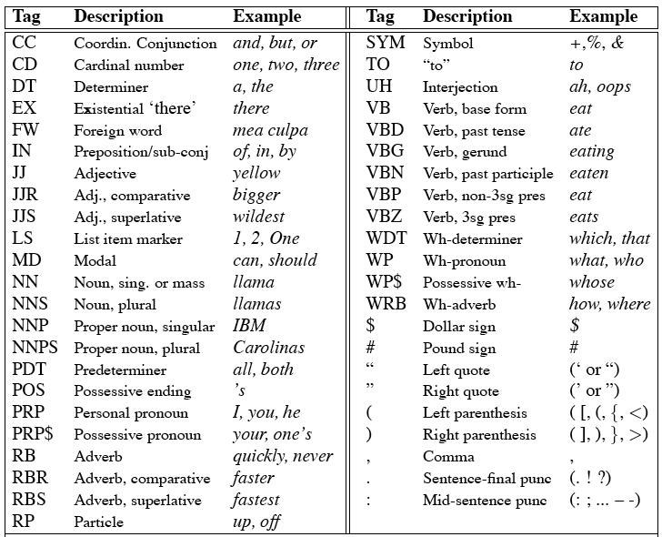
Penn Treebank Tagset
Notes:
14

Slide 15
Example of tagged sentence
The/DT grand/JJ jury/NN commmented/VBD on/IN a/DT number/NN of/IN other/JJ topics/NNS ./.
Notes:
15

Slide 16
Tag Ambiguity
Words often have more than one POS: back
The back door = JJ
On my back = NN
Win the voters back = RB
Promised to back the bill = VB
The POS tagging problem is to determine the POS tag for a particular instance of a word
Notes:
16

Slide 17
Tagging Whole Sentences with POS is Hard
Ambiguous POS contexts
E.g., Time flies like an arrow.
Possible POS assignments
Time/[V,N] flies/[V,N] like/[V,Prep] an/Det arrow/N
Time/N flies/V like/Prep an/Det arrow/N
Time/V flies/N like/Prep an/Det arrow/N
Time/N flies/N like/V an/Det arrow/N
…..
Notes:
17

Slide 18
Probabilistic Models of POS tagging
For tokens w1, ..., wn, find the most probable corresponding sequence of possible tags t1, ..., tn
We assume that probable means something like “most frequently observed in some manually tagged corpus of words”.
Penn Treebank II (a common training corpus)
1 million words from the Wall Street Journal
Tagged for POS (and other attributes)

Slide 19
Markov Model (bigrams)
Verb
Det
Start
Prep
Adj
Noun
Stop

Slide 20
Markov Model as a FSM
p(tag seq)
Verb
0.8
Det
0.3
0.7
Start
Prep
Adj
0.4
0.5
Noun
Stop
0.2
0.1
Start Det Adj Adj Noun Stop = 0.8 * 0.3 * 0.4*0.5 * 0.2

Slide 21
Methodology: Error Analysis
Confusion matrix:
E.g. which tags did we most often confuse with which other tags?
How much of the overall error does each confusion account for?
Machine Classification
 | VB | TO | NN
VB
TO
NN
Ground Truth

Slide 22
Evaluation Matrices 1
True Positives: Machine identified positives which are also similarly identified positives by human.
False Positives: Machine identified positives which have been identified as negatives as by human.
False Negatives: Machine identified negatives which have been identified as positives by human.
True Negatives: Machine identified negatives which have been identified as negatives by human.

Slide 23
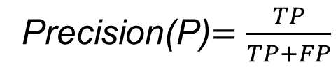
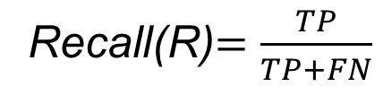
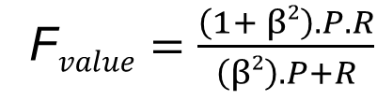
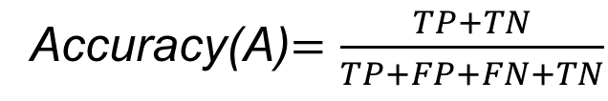
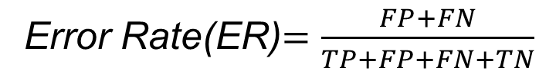
Evaluation Matrices 2
Recall(R)$=\frac{TP}{TP+FN}$
Precision(P)$=\frac{TP}{TP+FP}$
Error Rate(ER)$=\frac{FP+FN}{TP+FP+FN+TN}$
Accuracy(A)$=\frac{TP+TN}{TP+FP+FN+TN}$
F$value=\frac{\left(1+ β2\right).P.R}{\left(β2\right).P+R}$

Slide 24





Exercise : Two class evaluation
Recall(R)$=\frac{TP}{TP+FN}$
Computed YES | Computed NO
TP | FN
FP | TN
Precision(P)$=\frac{TP}{TP+FP}$
Error Rate(ER)$=\frac{FP+FN}{TP+FP+FN+TN}$
Accuracy(A)$=\frac{TP+TN}{TP+FP+FN+TN}$
Computed YES | Computed NO
500 | 25
100 | 5000
F$value=\frac{\left(1+ β2\right).P.R}{\left(β2\right).P+R}$

Slide 25
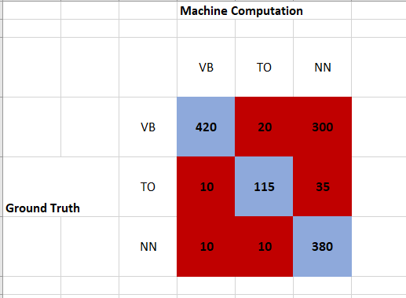
Multi Category Evaluation

Slide 26
Evaluating Tagging Approaches
For any NLP problem, we need to know how to evaluate our solutions
Possible Gold Standards -- ceiling:
Annotated naturally occurring corpus
Human task performance (96-7%)
How well do humans agree?
Kappa statistic: avg pairwise agreement corrected for chance agreement
Can be hard to obtain for some tasks: sometimes humans don’t agree
Baseline: how well does simple method do?
For tagging, most common tag for each word (91%)
How much improvement do we get over baseline?

Slide 28
Parsing
Identifying chunks or units in a clause.
The units have a function in the clause and these functions are attached together.
This is a step after POS tagging.
CFG parsing is recursive, hence difficult.
In practice use either Treebank grammar or even simpler Dependency parse.

Slide 29
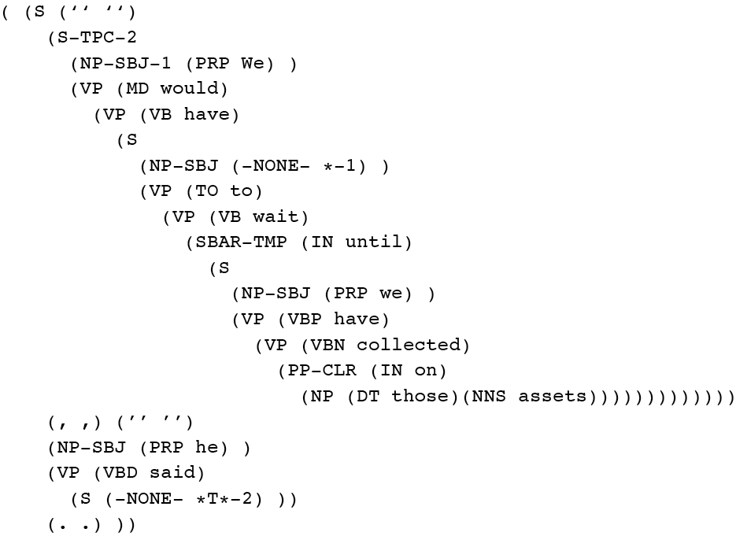
Penn Treebank
Penn TreeBank is a widely used treebank.
Most well known is the Wall Street Journal section of the Penn TreeBank.
1 M words from the 1987-1989 Wall Street Journal.

Slide 30
Treebank Grammars
Treebanks implicitly define a grammar for the language covered in the treebank.
Simply take the local rules that make up the sub-trees in all the trees in the collection and you have a grammar.
Not complete, but if you have decent size corpus, you’ll have a grammar with decent coverage.

Slide 31


Treebank Grammars
Such grammars tend to be very flat due to the fact that they tend to avoid recursion.
To ease the annotators burden
For example, the Penn Treebank has 4500 different rules for VPs. Among them...

Slide 32
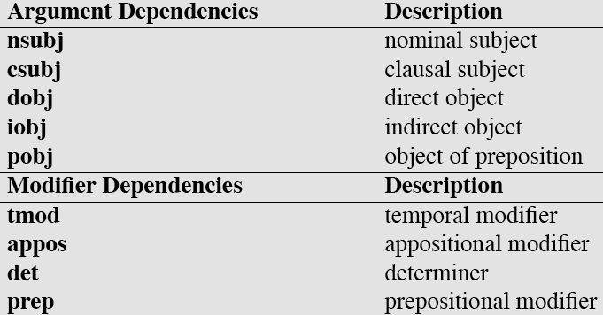
Dependency Relations

Slide 33
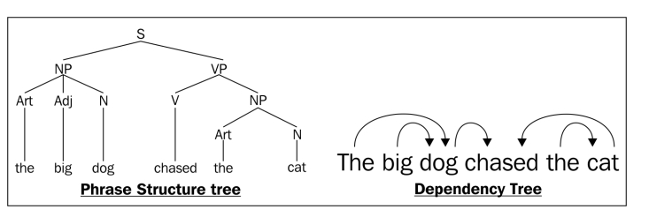
Dependency Parsing
Each linguistic word is connected via a directed link.
The parse tree captures the (unidirectional) relationship between words and phrases.

Slide 34
Sample Code for last lab Demo code for this session

